Slide 1
JOB APPLICATION TRACKING SYSTEM
Team leader :J Theporal lisha Team member1 :M Deepika Team member2 :S Ranjani Team member3 : R Anusuya

Slide 2
INTRODUCTION
What is an Applicant Tracking System?
An Applicant Tracking System or ATS is an all-in-one human resource software that automates the hiring process, helps HR teams efficiently manage every part of recruitment (from job posting to onboarding), and solves recruiters’ challenges and pain points.
Specifically, the ATS:
Stores job candidate information like resumes, cover letters, references, and other recruitment and hiring data that HR teams can easily access and organize.
Tracks job candidates and their application status throughout the hiring pipeline.
Weeds out unqualified candidates and recommends the best fit for a position based on the parameters set by HR. Only those on the shortlist are moved to the next stage of the hiring process.
Automates time-consuming administrative tasks such as manually screening applicants, reading resumes, scheduling interviews, and sending notifications and emails to job candidates and employees.

Slide 3
PURPOSE OF ATS
The primary goal of an Applicant Tracking System is to simplify the recruitment process and to make it more effective and efficient. This is accomplished by giving recruiters access to a powerful, centralized platform on which to collect and view applicants, track their progress, and filter them out based on their qualifications

Slide 4
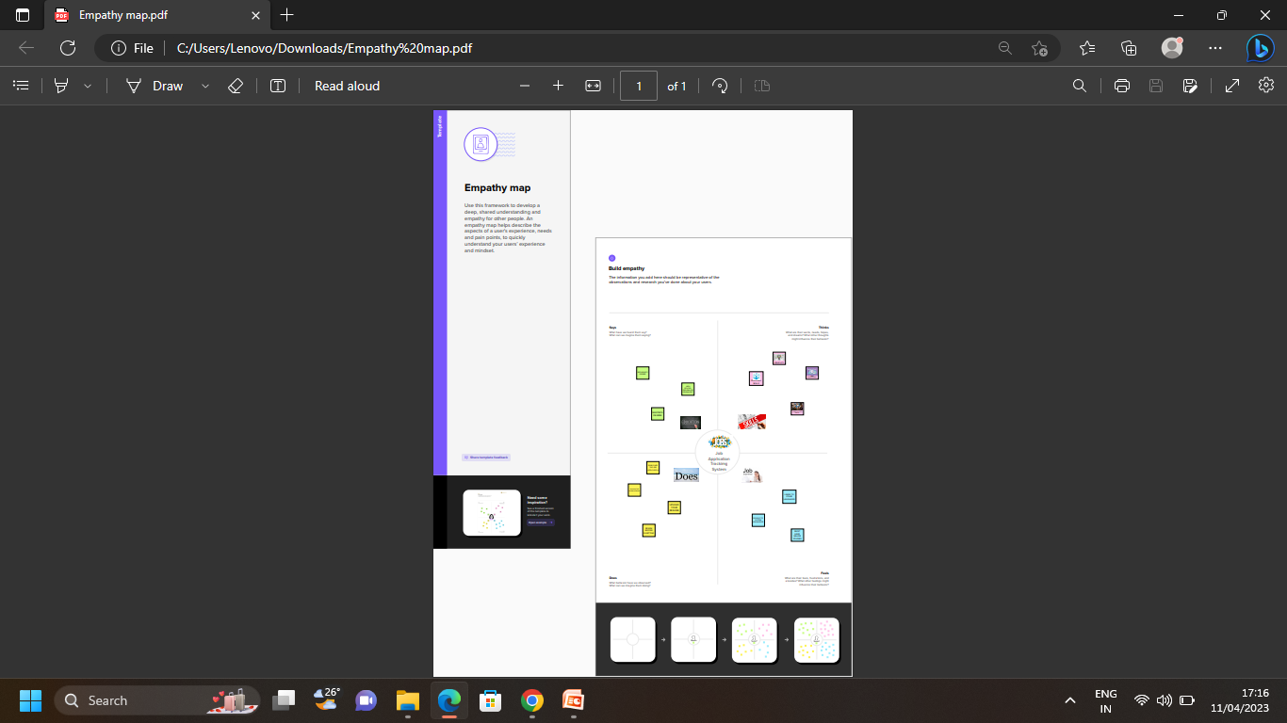
EMPATHY MAP

Slide 5
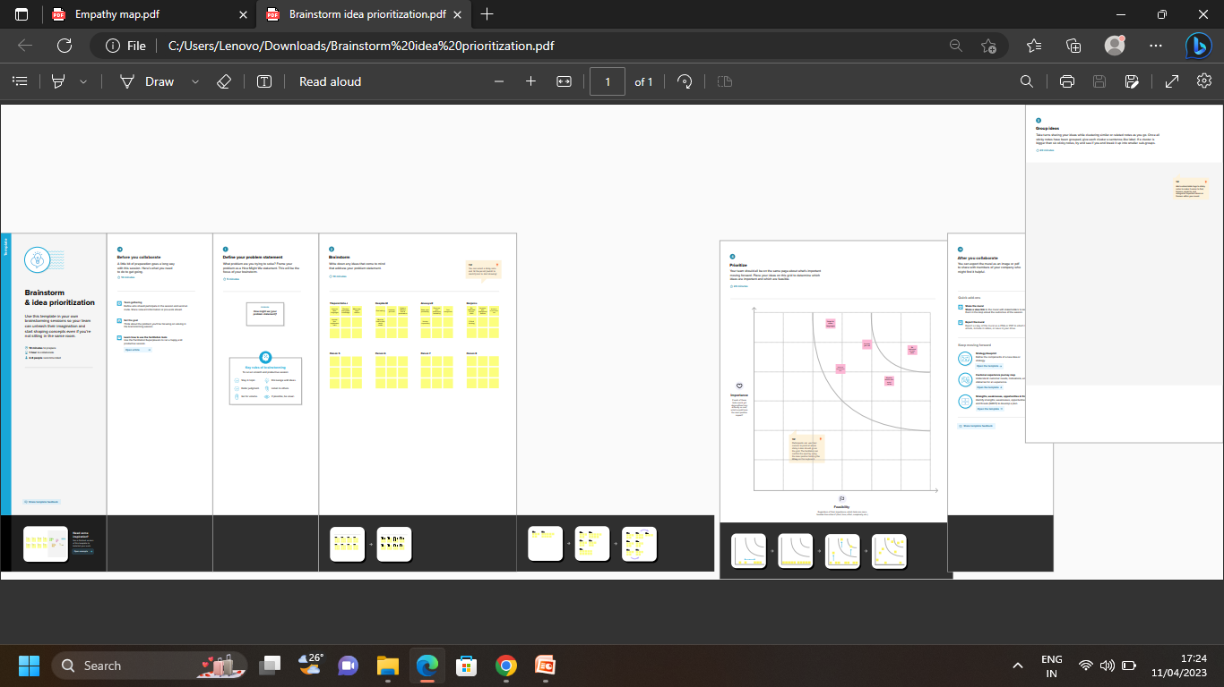
IDEATION & BRAINSTROMING MAP

Slide 6
DATA MODEL

Slide 7
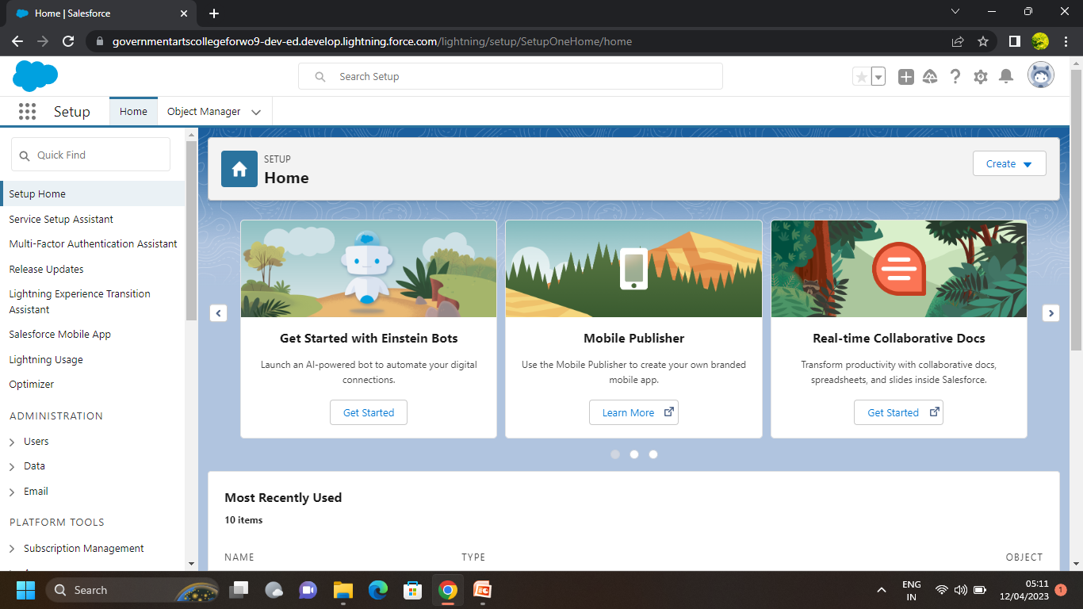
MILESTONE 1 :Creating a salesforce developer org
SALESFORCE : Salesforce is your customer success platform, design to help you sell ,service , market ,analyze, and connect with your customers

Slide 8
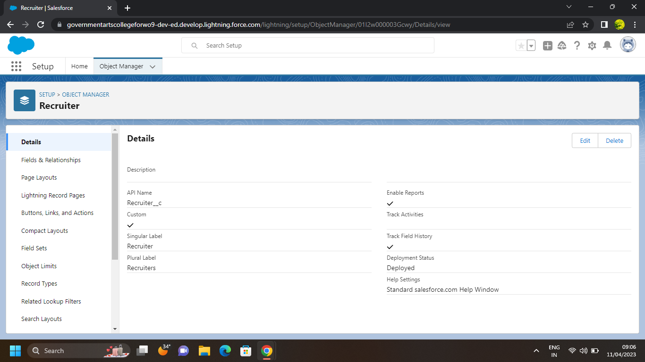
MILESTONE 2 : OBJECT Activity 1 : create a custom object
OBJECT : Salesforce object are database tables that permit you to store data that is specific to an organization .

Slide 9
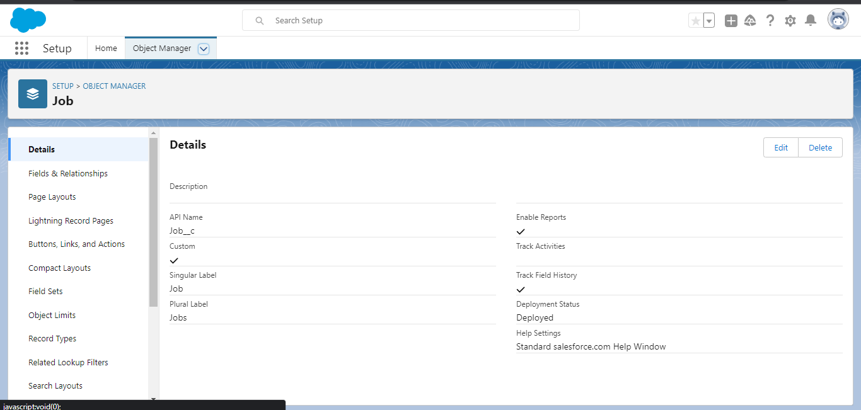
Activity 2 : create a job
CUSTOM OBJECT : Custom objects are those objects that are creater by users. They supply information that is unique and essential to their organization

Slide 10
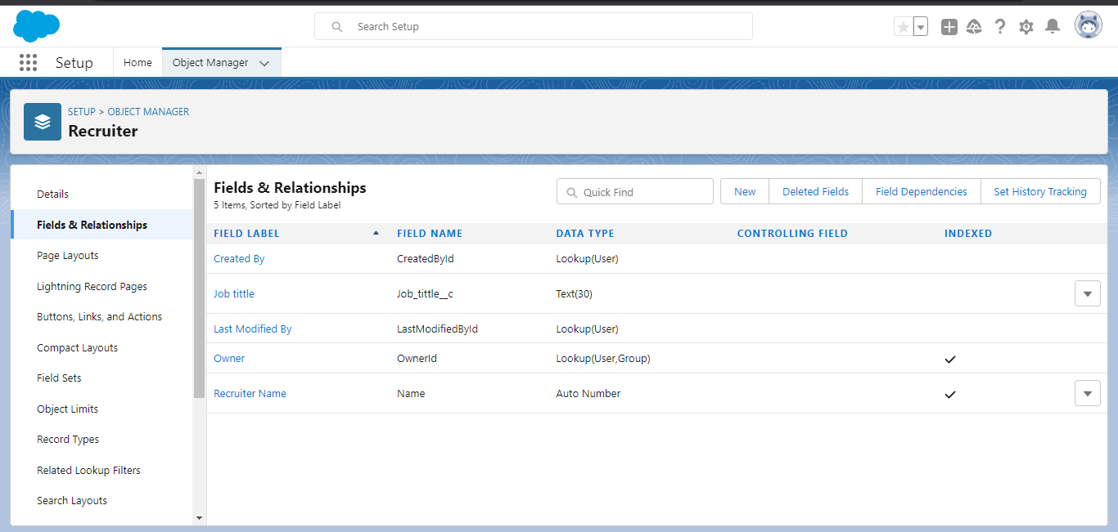
MILESTONE 3 : FIELDS Activity 1: Create a custom field
FIELDS : Fields in salesforce represents what the columns represents in relational data bases .

Slide 11
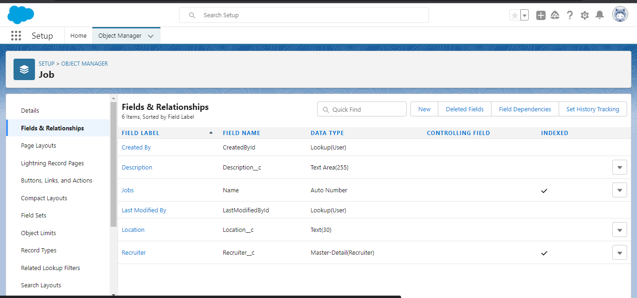
Activity 2 : creation of master-detail relationship
CUSTOM FIELDS : The custom field which are added by the administrator /developer to meet the business requirement of any organizations .

Slide 12
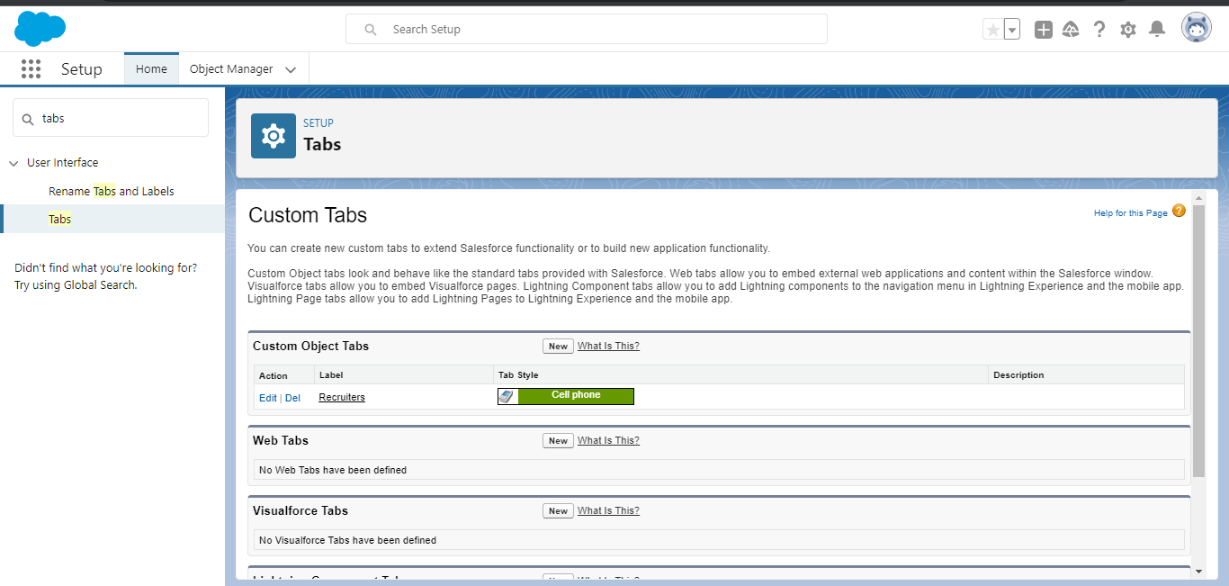
MILESTONE 4 : TAB Activity 1 : Create a tab
TAB : In salesforce ,a tab is a user interface element that allows users to navigate to different sections of the platform ,such as accounts

Slide 13
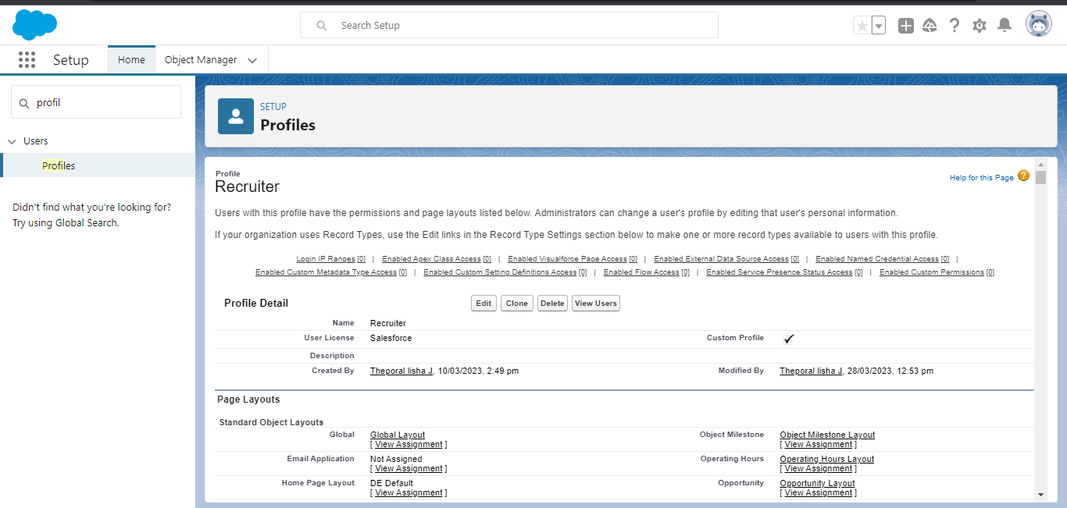
MILESTONE 5: PROFILE Activity 1 : Create a custom profile
PROFILES : A profile is a group /collection of setting and permission that define what a user can do in salesforce .

Slide 14
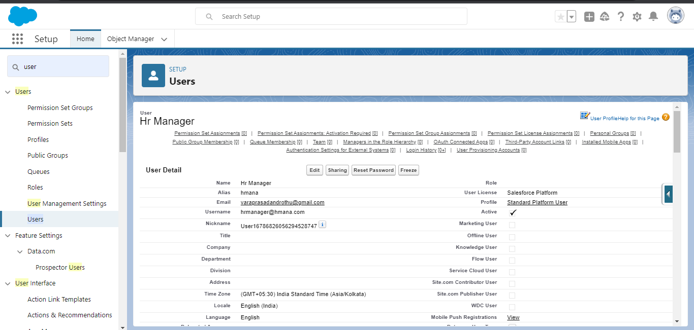
MILESTONE 6 : USER Activity 1 : To create a user
USER : A user is anyone who loges in to salesforce .Users are employees at your company such a sales reps.

Slide 15
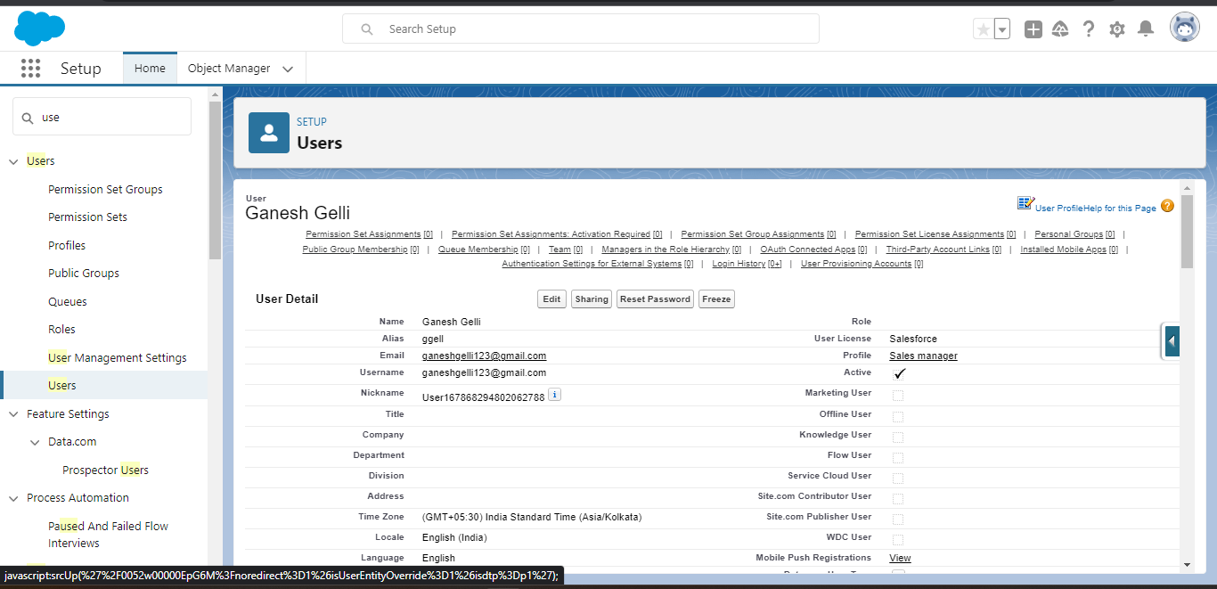
Activity 2 :create a user with a username as ‘Ganesh gelli’
USER: The user account identifies the user ,and the user account settings determined thar features and records the user can access

Slide 16
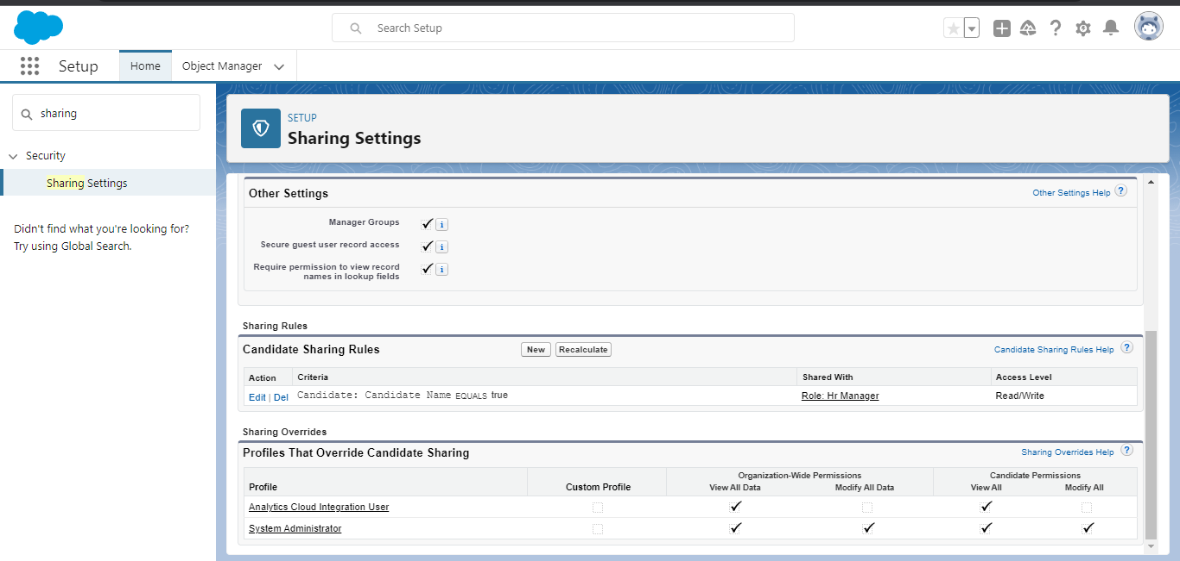
MILESTONE 7 : SHARING RULES Activity 1 : Create a sharing rule
SHARING RULES: Sharing rules help user to share records based on conditions

Slide 17
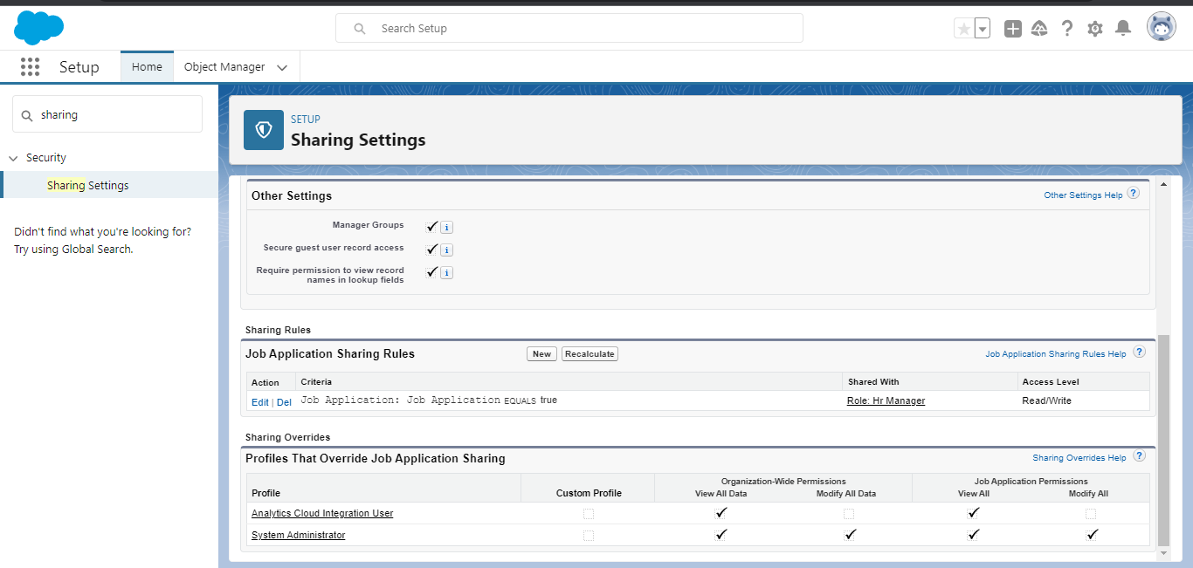
Activity 2 : create a sharing rule
TYPES OF SHARING RULE:
1.Owner –based sharing rules
2.Criteria-based sharing rules

Slide 18
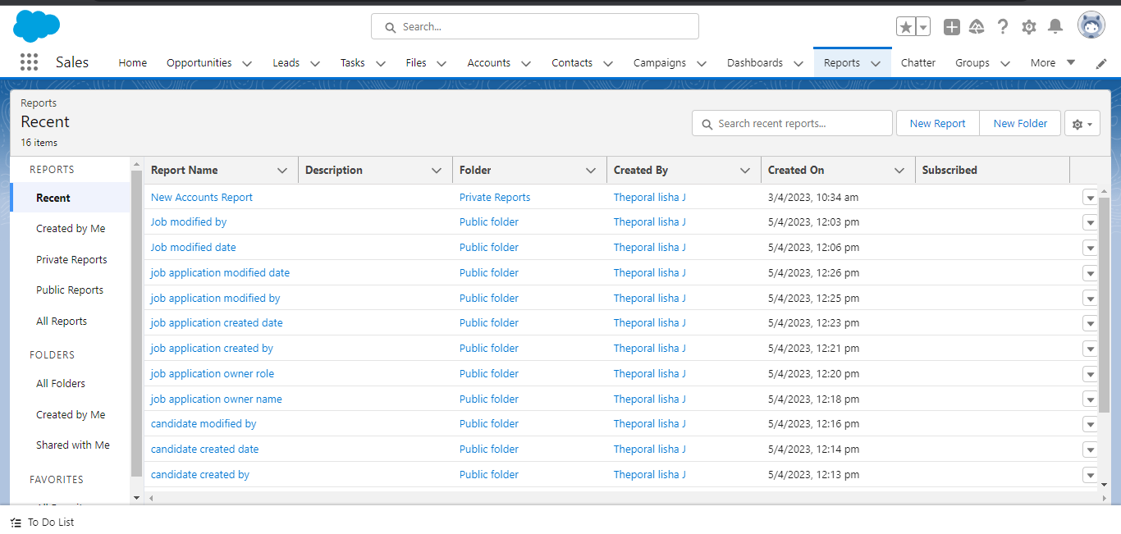
MILESTONE 8 : REPORTS Activity 1 : create a report
REPORTS : A report is list of records that meet the criteria you define .

Slide 19
Trailhead profile public URL
Team leader : https://trailblazer.me/id/ljesuraj
Team member1: https://trailblazer.me/id/danitha8
Team member2: https://trailblazer.me/id/ran037
Team member3: https://trailblazer.me/id/anusr53

Slide 20
ADVANTAGE & DISADVANTAGE
Reduces time spent on admin tasks. ...
Resume and CV screening. ...
Speeds up the recruitment cycle. ...
Improves the quality of hire. ...
Enhances reporting and compliance. ...
Boosts your brand. ...
Improves onboarding.

Slide 21
APPLICATIONS
1. Pinpoint — Best applicant tracking system for in-house talent acquisition and people teams
2. VidCruiter — Best applicant tracking system for high volume recruiting and candidate screening
3. monday.com — Best applicant tracking system for customized workflows
4. ClearCompany — Best applicant tracking system for usability and automation
5. Trakstar — Best applicant tracking system for collaborative hiring tools
6. Recruit CRM — Best hybrid applicant tracking system + CRM solution
7. Tracker — Best applicant tracking system for recruitment and staffing firms
8. Recruitee — Best applicant tracking system for automated notifications
9. PCRecruiter — Best applicant tracking system for detailed recruitment analytics
10. Eddy — Best applicant tracking system for small, local businesses

Slide 22
CONCLUSION
Conclusion. Applicant Tracking System for recruiters is a very effective hiring solution that most of the successful recruiters utilize. Because without it, there is a good chance that your process of moving applicants through different stages can become very difficult

Slide 23
FUTURE SCOPE
The world knows that Applicant Tracking Systems (ATS) made their way into the recruitment domain just a few years ago. Although, previously, ATS solutions were implemented only by a few companies that could bear the heavy investment costs, now their use in the HR arena has risen to a great extent. According to a recently released survey report, the majority of staffing firms worldwide will opt for an Applicant Tracking System by the end of 2020 to improve the overall talent acquisition efficacy, in this scope the future of ATS definitely looks bright.

